Slide 1


Identification of malwares from Windows PE files
Artificial Intelligence for Cybersecurity Project
AY 2024/2025
Matteo Giannini
Giacomo Lombardi

Slide 2







Identification of malwares from Windows PE files
Goal Definition
Data Acquisition and Data Exploration
Data Preprocessing
Data Processing
Table of Contents
Result Summary and Relevant Insights
xAI
References

Slide 3

Classification Problem
Goal Definition
Developing a machine learning model capable of classifying Windows Portable executable (PE) files as malicious or bening based on static features extracted from the files themselves.
To achieve this objective, the dataset used consists of PE file characteristics extracted from a collection of Windows executable and DLL files. Each entry represents a unique file with various attributes extracted from its PE header and structure. The dataset includes both benign software samples and known malware samples.

Slide 4
Identification of malwares from Windows PE files
Goal Definition
Data Acquisition and Data Exploration
Data Preprocessing
Data Processing
Table of Contents
Result Summary and Relevant Insights
xAI
References

Slide 5
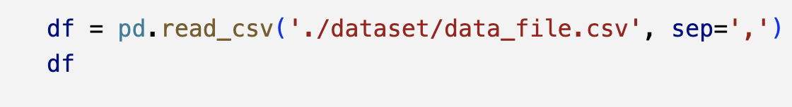
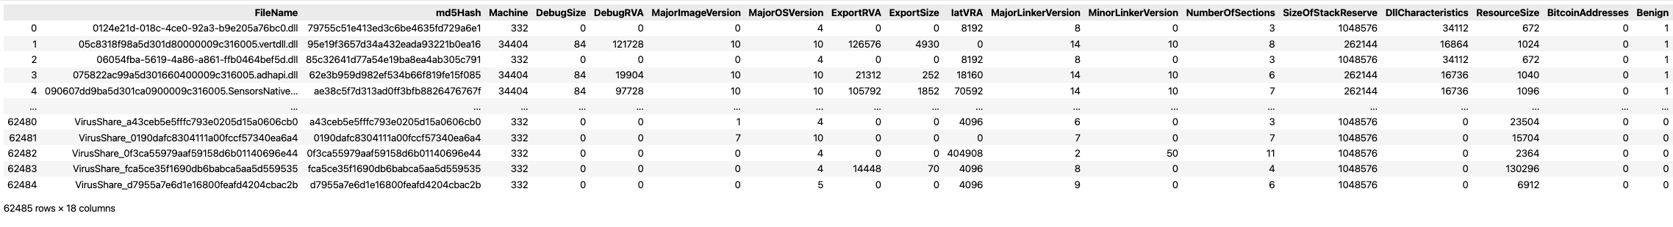
Dataset Features
Description
Data Acquisition and Data Exploration

Slide 6
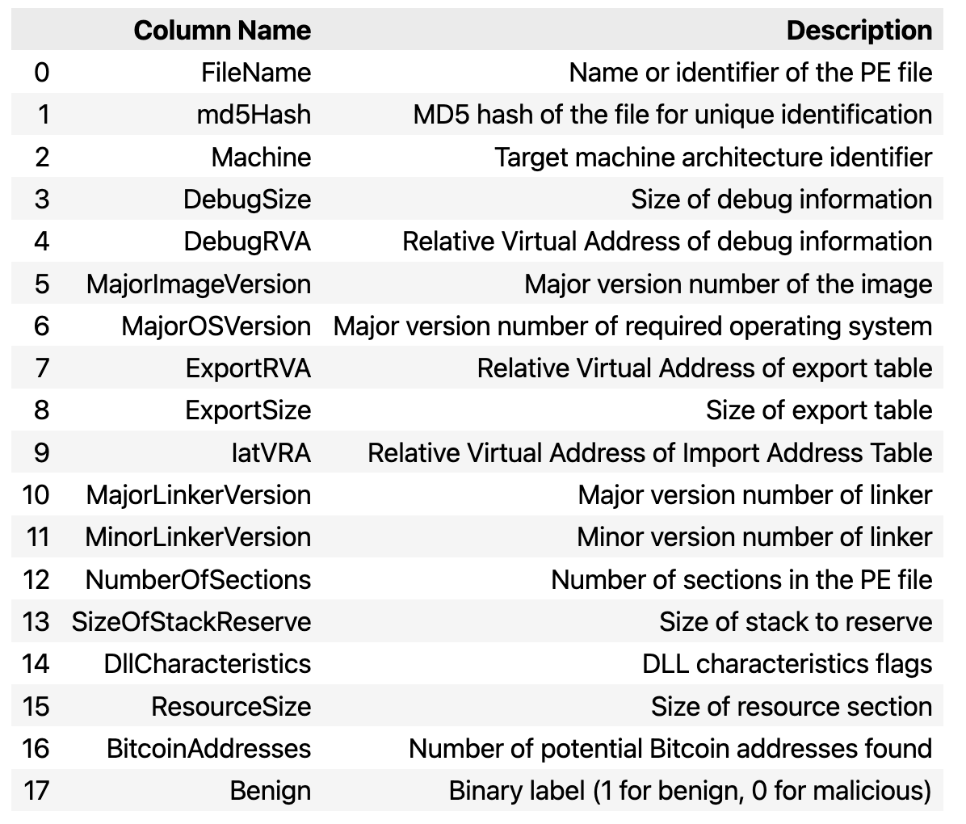
Dataset Features
Description
Data Acquisition and Data Exploration
The dataset is composed of 17 features, plus the column named 'Benign' representing the class

Slide 7
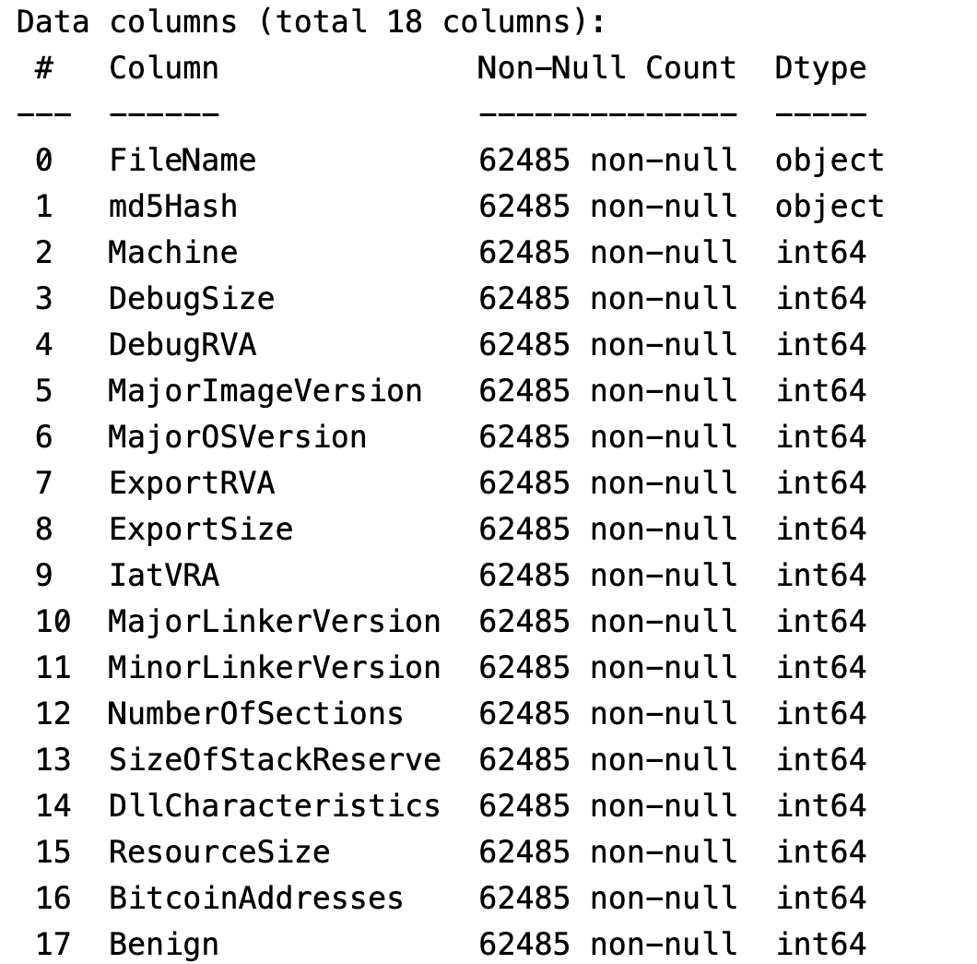
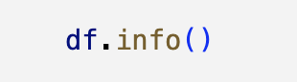
Dataset Features
Feature Types
Data Acquisition and Data Exploration
Almost all of the features except for ‘FileName’ and ‘md5Hash’ are numerical but from further analysis, based on domain knowledge, we can say that some of them are really numerical and others are categorical
After identifying numerical, categorical and binary variables we converted the categorical columns into the type ‘category’ and we left the numerical columns in the original type int64

Slide 8
Dataset Features
Categorical and Numerical Features
Data Acquisition and Data Exploration
Categorical Features
- Machine: CPU for which the file was designed (it has 6 unique values).
- MajorImageVersion: main version of the software.
- MajorOSVersion: main version number of the required operating system.
- MajorLinkerVersion: main version number of the linker that created the file.
- MinorLinkerVersion: secondary version number of the linker that created the file.
- DllCharacteristics: under which circumstances to initialize the DLL.
- NumberOfSections: number of sections the PE file should contain.
Numerical Features
- DebugSize: size of the debug information.
- DebugRVA: Relative Virtual Address (RVA) of the debug information.
- ExportRVA: RVA of the export table.
- ExportSize: size of the export table.
- IatVRA: RVA of the Import Address Table (IAT).
- SizeOfStackReserve: amount of memory to reserve for the initial thread stack.
- ResourceSize: size of the resources.

Slide 9
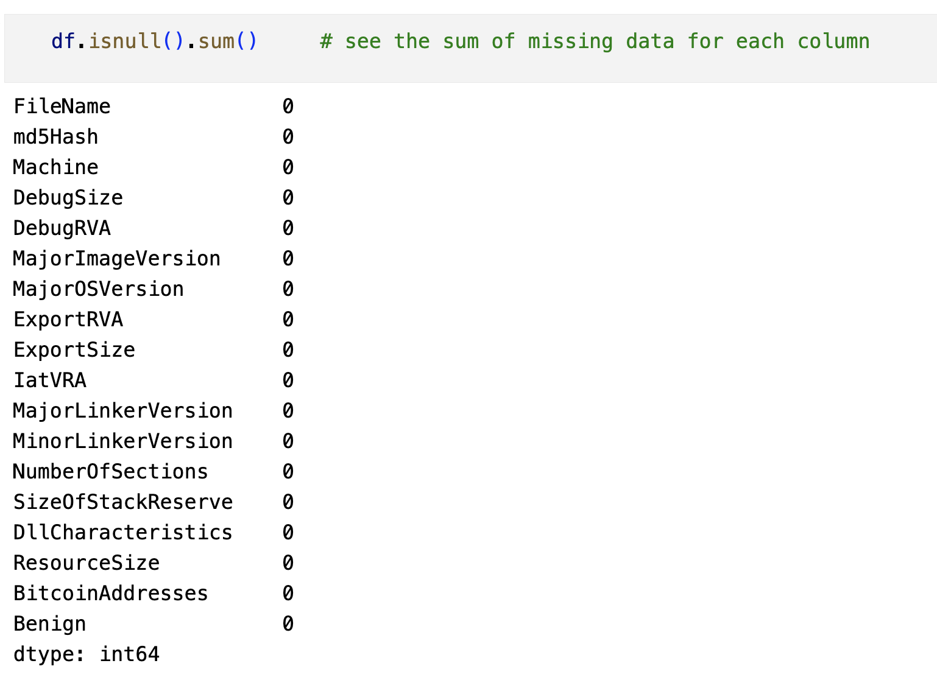
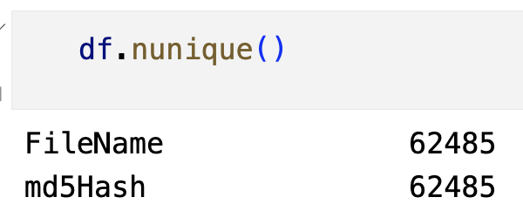



Dataset Features
Null and Unique Values
Data Acquisition and Data Exploration
No missing data
Unique values for each instance, so they do not provide useful information for the classification problem
No need to manage them in preprocessing phase

Slide 10
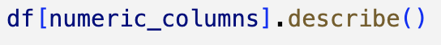
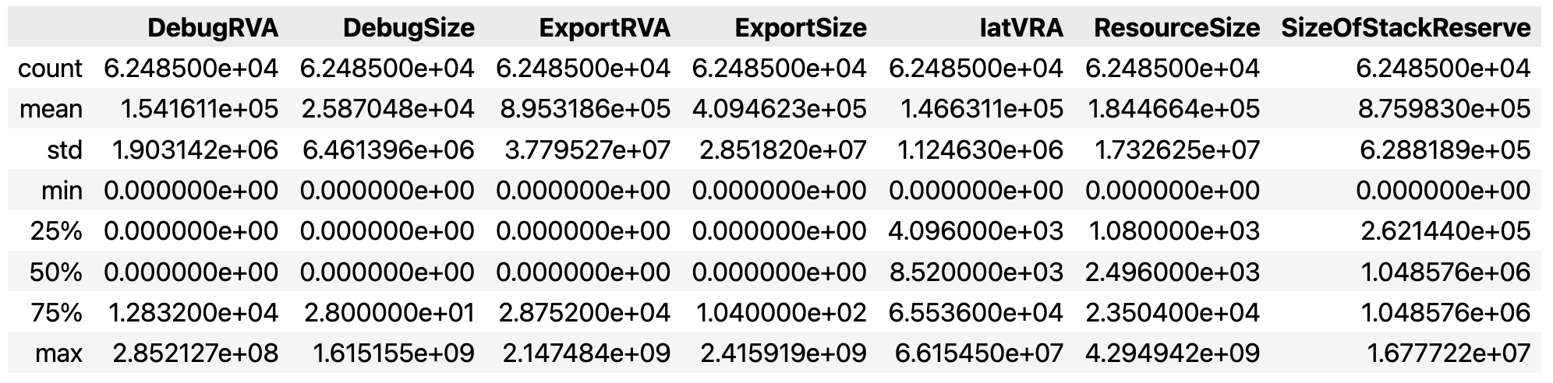
Dataset Features
Distribution of Numerical Features
Data Acquisition and Data Exploration
Normalization necessary for Logistic Regression classifier
Different ranges

Slide 11
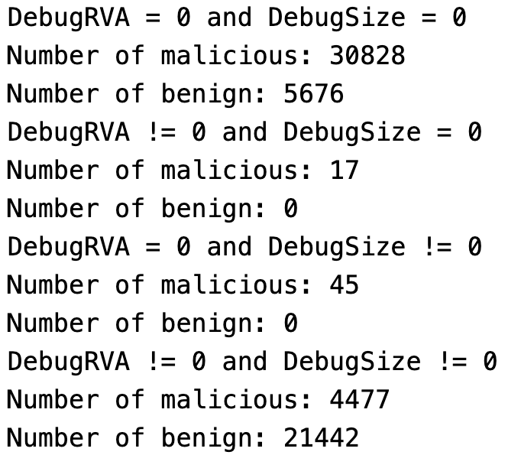
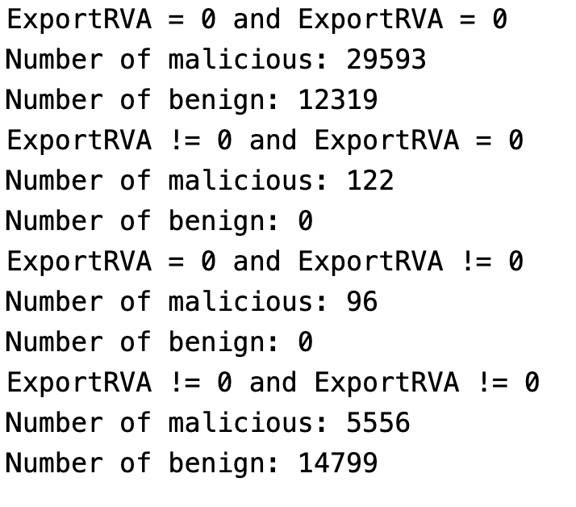
Dataset Features
Importance of zeroes in numerical features
Data Acquisition and Data Exploration
Lots of 0s
Significant for the classification

Slide 12
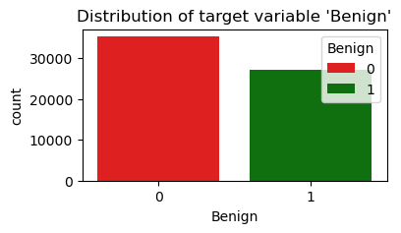
Variables Plot
Distribution of target variable
Data Acquisition and Data Exploration
Balanced Dataset
Unusual for this type of dataset

Slide 13
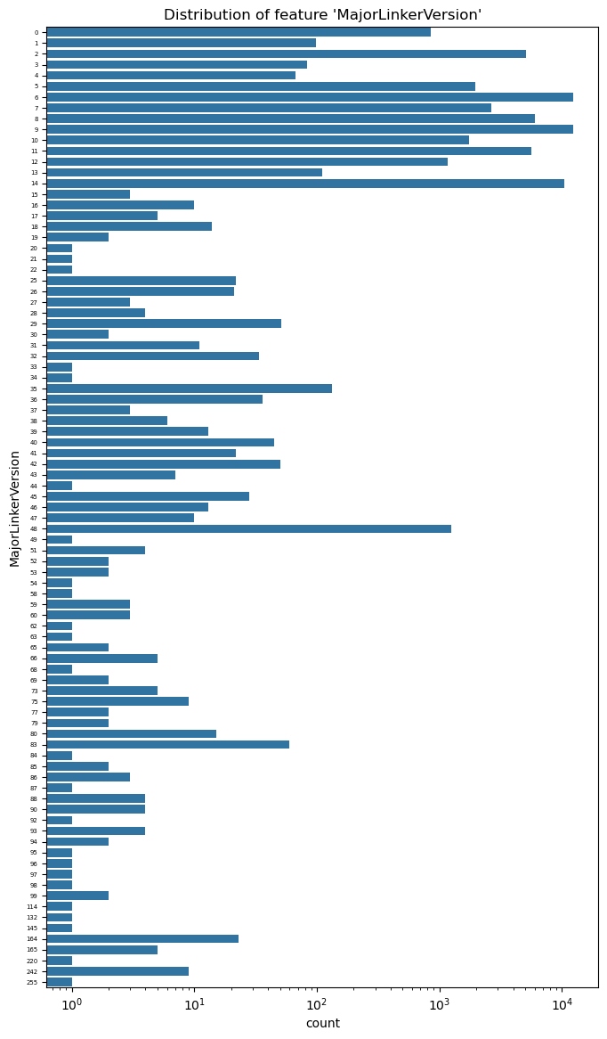
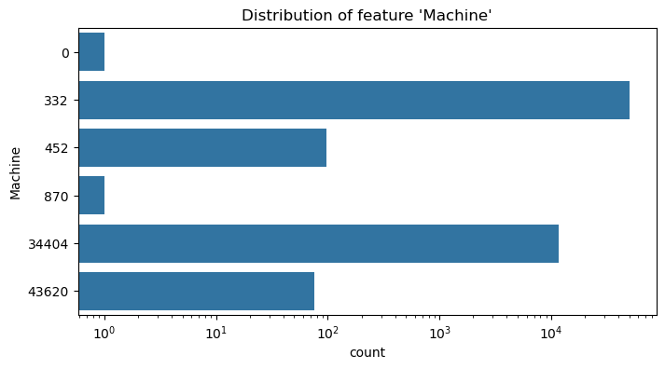
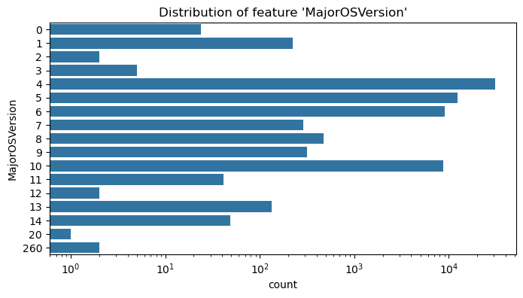
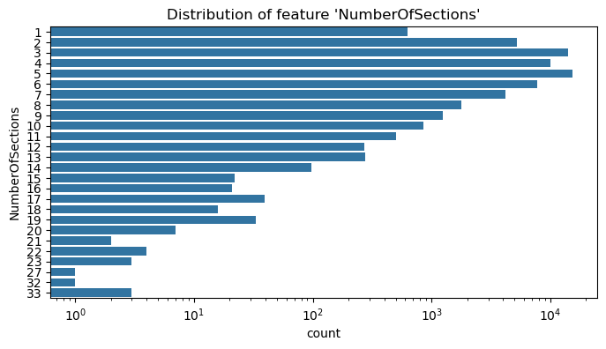
Variables Plot
Distribution of categorical variables
Data Acquisition and Data Exploration

Slide 14
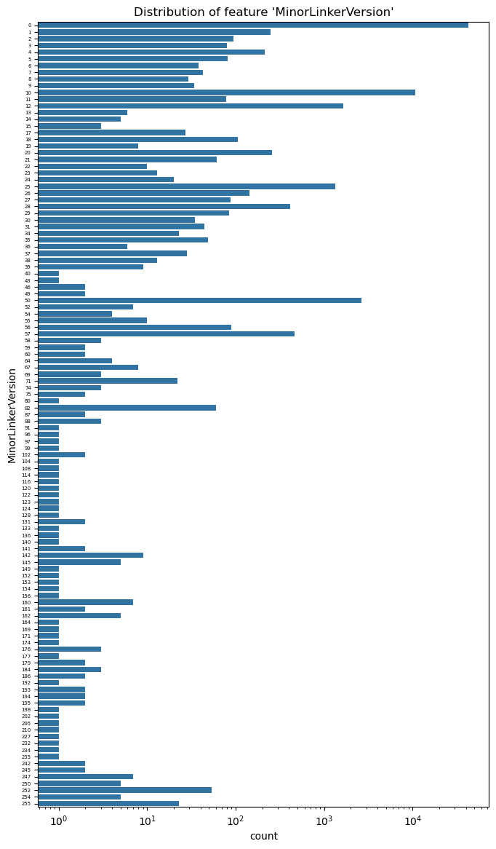
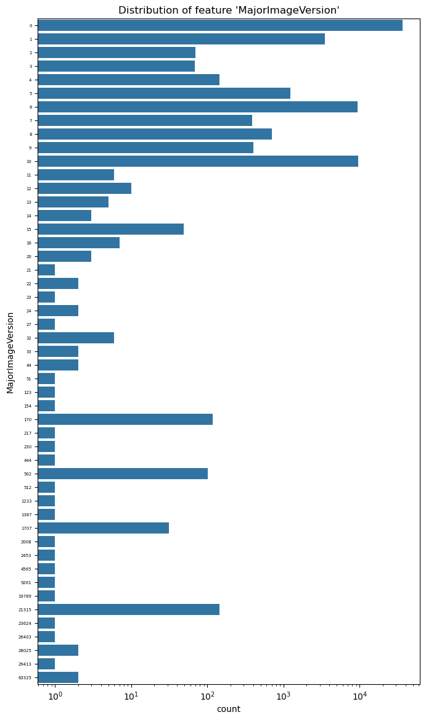
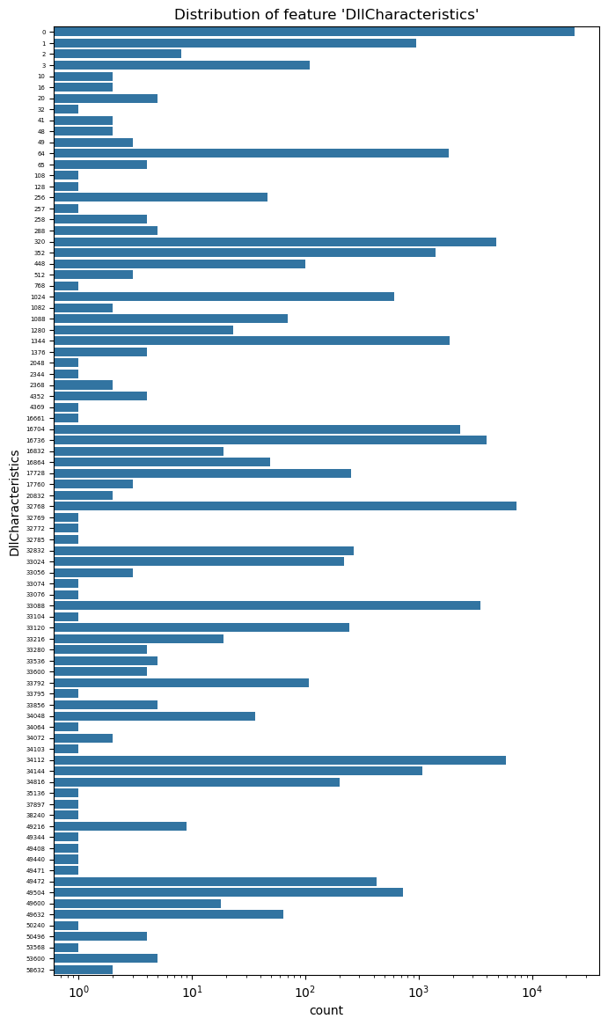
Variables Plot
Distribution of categorical variables
Data Acquisition and Data Exploration

Slide 15
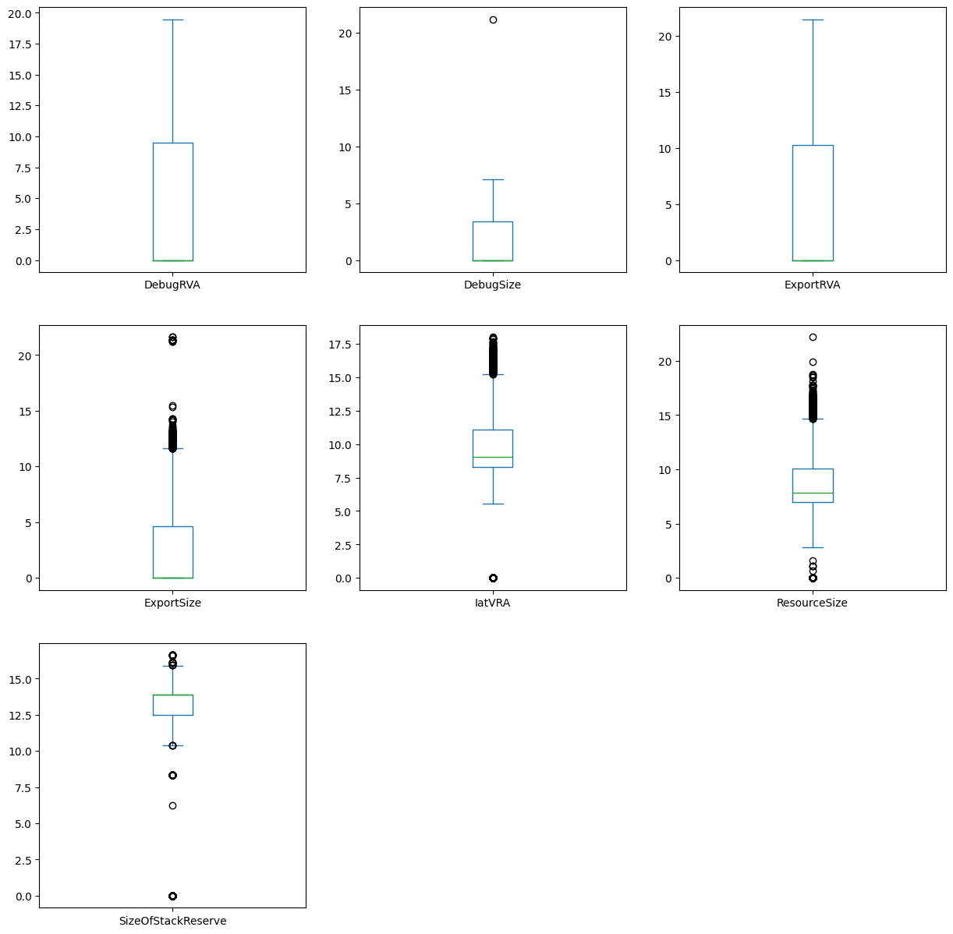
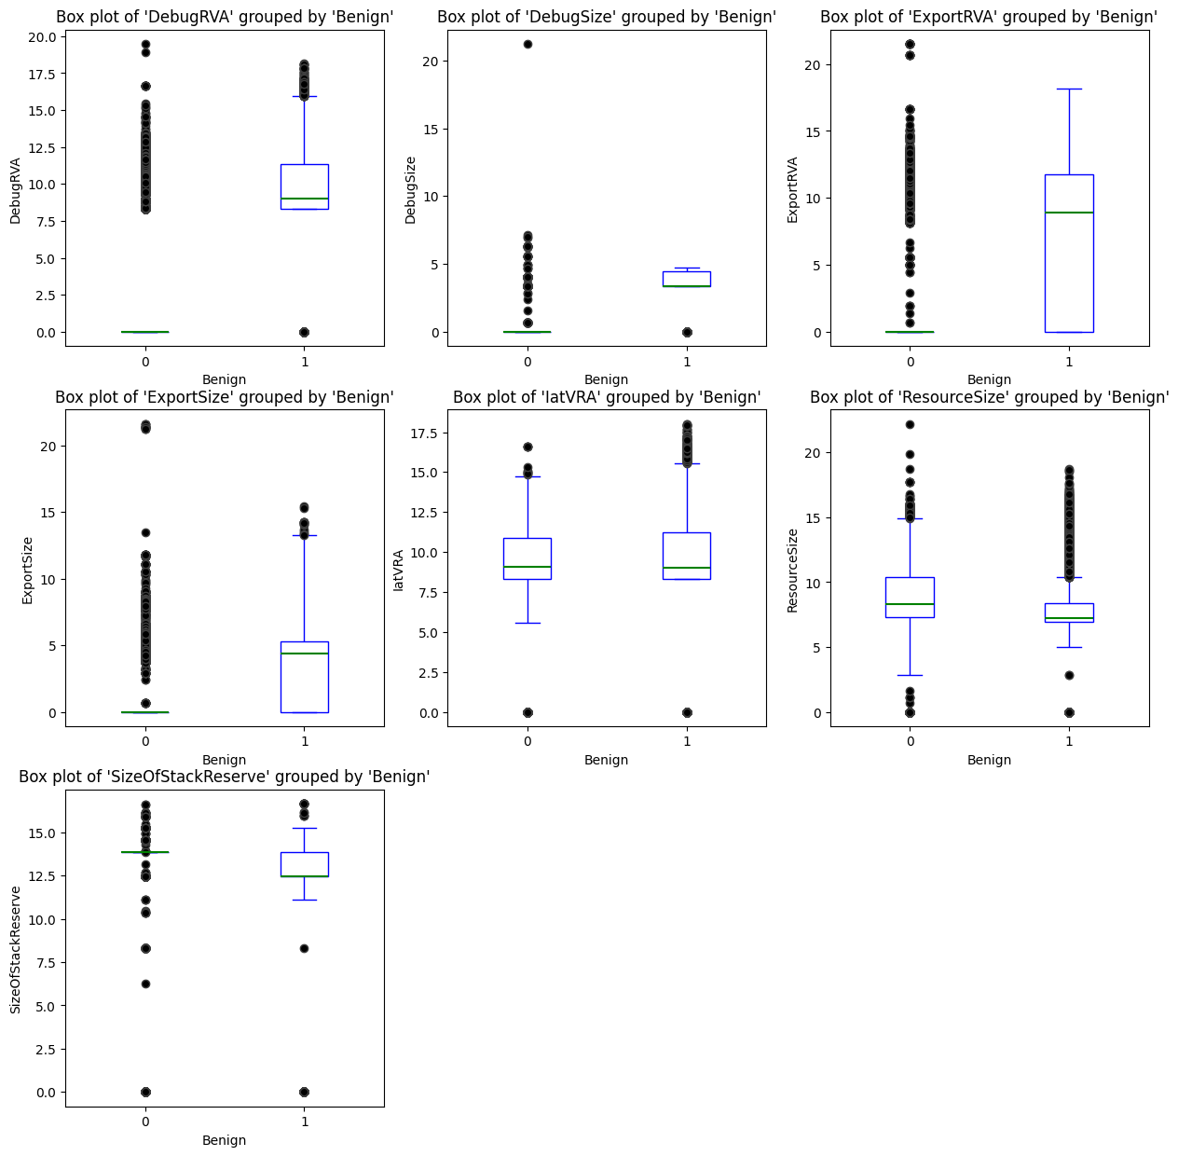
Variables Plot
Numerical Variables Box Plots
Data Acquisition and Data Exploration

Slide 16
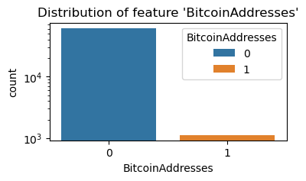

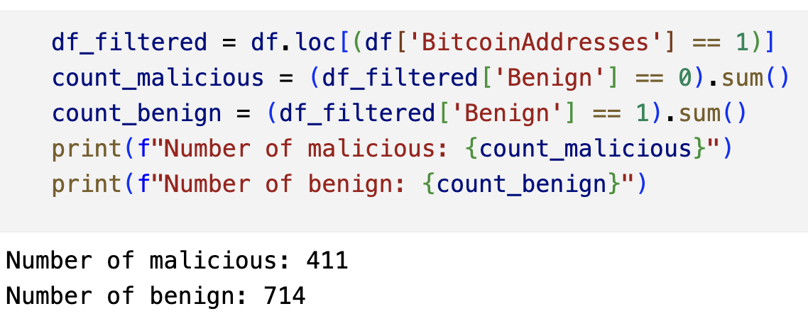
Variables Plot
Distribution of BitcoinAddress
Data Acquisition and Data Exploration
Lots of 0s
+
No relevance of 1s
=
Feature removal

Slide 17
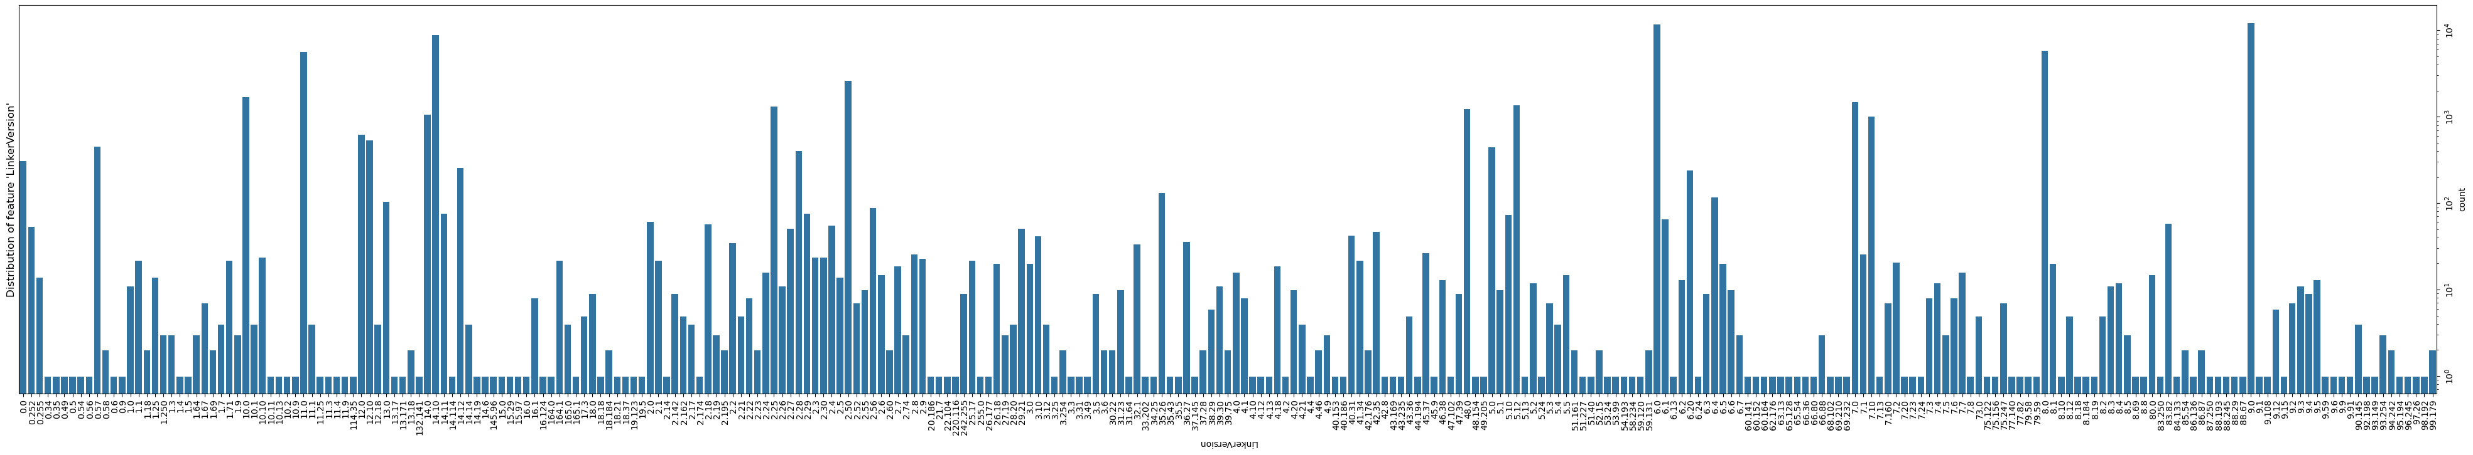
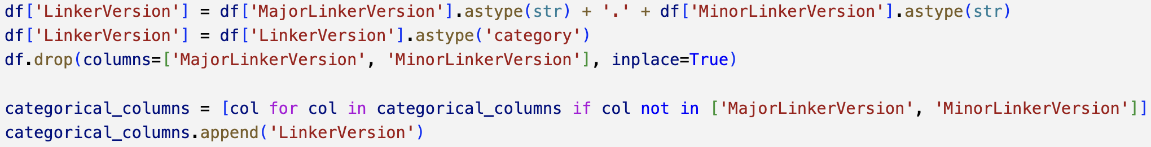
Dataset Feaures
Merging ‘MajorLinkerVersion’ and ‘MinorLinkerVersion’
Data Acquisition and Data Exploration
Considering the meaning of 'MajorLinkerVersion' and 'MinorLinkerVersion' we can think of merging them in a single variable called 'LinkerVersion'.

Slide 18
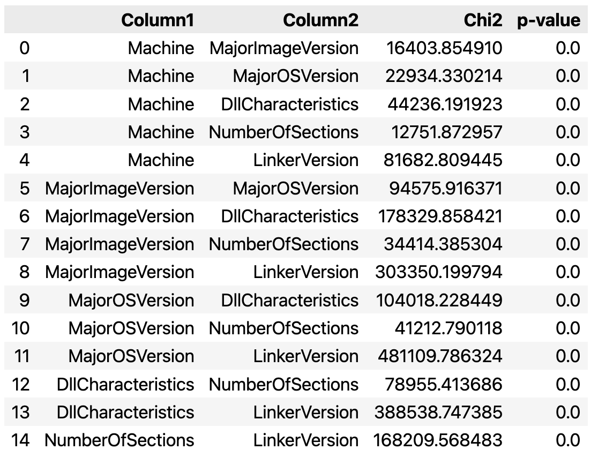
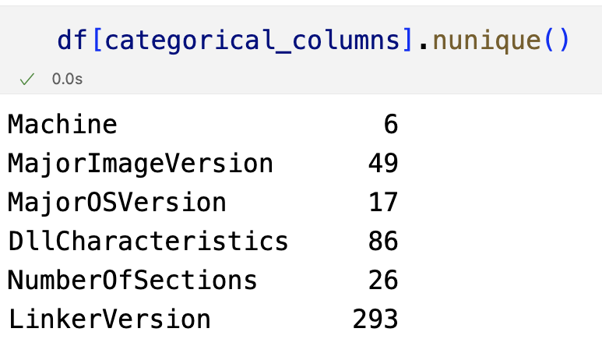
Variables Correlation
Categorical Variables Correlation with Chi2 Test
Data Acquisition and Data Exploration
No statistical relevance: All p-values are equal to 0 due to the high number of categories.

Slide 19
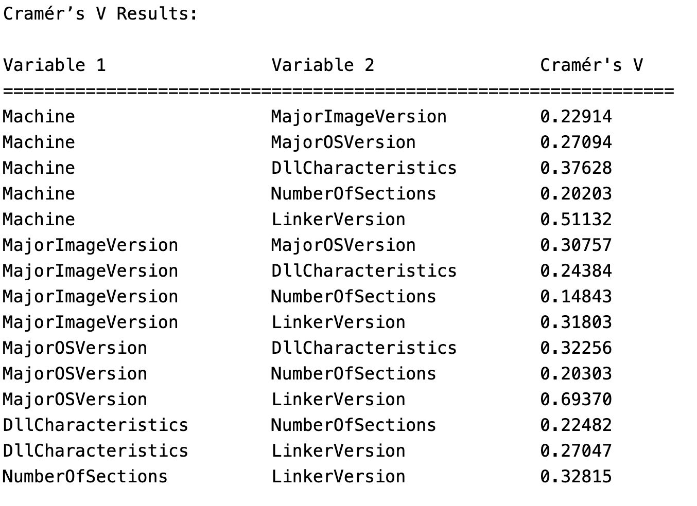
Variables Correlation
Categorical Variables Correlation with Cramer’s V Index
Cramér’s V is a statistical measure used to assess the strength of association between two categorical variables. It is based on the chi-squared statistic and provides a value between 0 and 1, where 0 indicates no association and 1 indicates a strong association. Unlike the chi-squared test alone, Cramér’s V is normalized, making it easier to compare relationships across variables with different sizes or category counts.
While there’s no universal scale, common interpretations of Cramér’s V values are:
[0,0.10] → Very weak association
[0.10,0.30] → Weak association
[0.30,0.50] → Moderate association
>0.50 → Strong association
In our case we can see that most of the variables are weakly correlated
Data Acquisition and Data Exploration

Slide 20
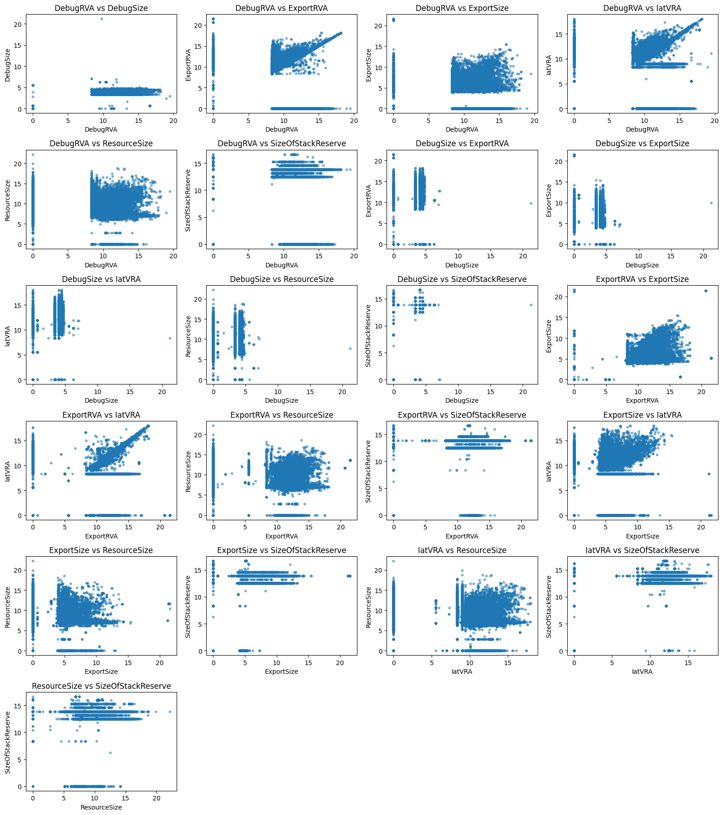
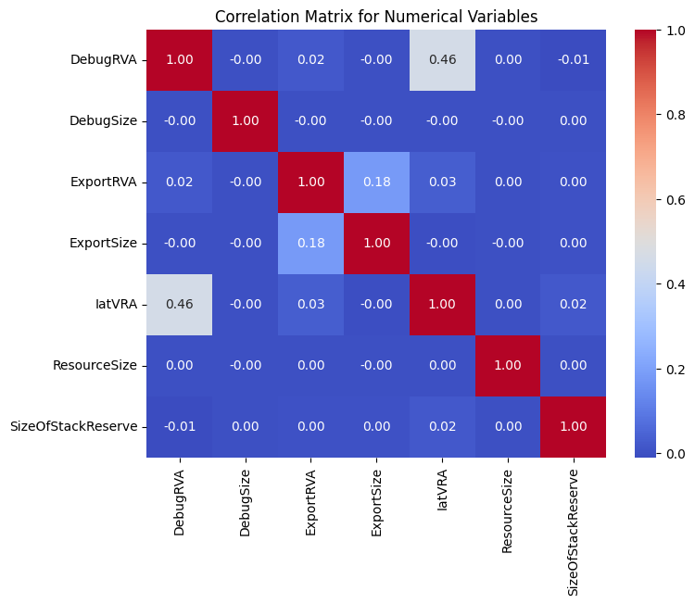
Variables Correlation
Numerical Variables Correlation with Scatter Plots and Correlation Matrix
Data Acquisition and Data Exploration
Given the correlation matrix and the scatter plots, we can see that the numerical variables are mostly uncorrelated with the exception of IatVRA and DebugRVA

Slide 21
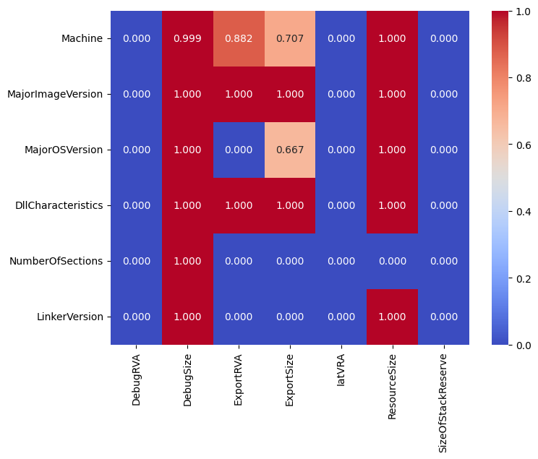
Variables Correlation
Numerical and Categorical Variables Correlation with ANOVA Test
Data Acquisition and Data Exploration
Given the results of the correlation matrix drawn with the ANOVA test we can see that most of the categorical variables are correlated with numerical variables. For this reason, in the following processing phase we will try to classify malwares using numerical and categorical variables separately

Slide 22
Identification of malwares from Windows PE files
Goal Definition
Data Acquisition and Data Exploration
Data Preprocessing
Data Processing
Table of Contents
Result Summary and Relevant Insights
xAI
References

Slide 23
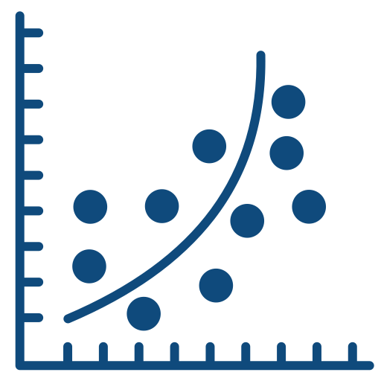




Needed Preprocessing
Due to the correlation seen between numerical and categorical variables from the ANOVA test we decided to conduct three types of experiments with two different classifiers with data implying three different types of preprocessing:
Data Preprocessing
Use of Logistic Regression
Use of Random Forest
Use of Numerical Features
Use of Categorical Features
Use of Whole Dataset
Use of Numerical Features
Use of Categorical Features
Use of Whole Dataset
StandardScaler
One-Hot Encoding
One-Hot Encoding
StandardScaler
SelectFromModel
No Preprocessing Needed
One-Hot Encoding
One-Hot Encoding of Categorical Variables

Slide 24

Use of the Pipeline
Data Preprocessing
We adopted the use of a Pipeline to prevent data leakage, ensuring that all preprocessing steps are fitted only on the training set and then applied to the test set. In fact, test data remains completely unseen until prediction.
Our first step is to analyze the various preprocessing techniques used across the different pipelines.

Slide 25
Feature Selection: SelectFromModel
StandardScaler
OneHotEncoder
Data Preprocessing
From our exploration of numeric features, we have observed that they have different ranges, which could pose a problem for the Logistic Regression classifier.
Since our categorical features do not have a meaningful order, we encode them with One Hot Encoding in all experiments where they’re used.
Even though decision trees usually handle directly categorical variables, the scikit variant requires the encoding with some type of encoder such as One-Hot, hence the decision of using this type of encoding even when Random Forest is used.
We used SelectFromModel in experiments with Logistic Regression when using the entire dataset, as it automatically selects the most important features based on the model's feature importance.
We normalize numeric features using Standard Scaler in the experiments involving Logistic Regression that utilize numeric features.
It works by fitting a model that assigns importance scores to each feature—such as coefficients in linear models or feature importances in tree-based models—and then selects features whose importance exceeds a given threshold.

Slide 26
Identification of malwares from Windows PE files
Goal Definition
Data Acquisition and Data Exploration
Data Preprocessing
Data Processing
Table of Contents
Result Summary and Relevant Insights
xAI
References

Slide 27



Choice of CrossValidation
Data Processing
For each of our data processing we used cross validation. This method is used for three main reasons:
Prevents overfitting: It helps detect if the model is too closely fitting the training data and not generalizing well.
More reliable evaluation: Instead of testing the model on a single train-test split this methods permits to average the results over several splits for a more stable estimate.
Better use of data: All data gets used for both training and testing at different points.
In our case we use k-fold cross-validation, splitting data into k (in our case 10) folds, and training the model on k–1 folds and testing it on the remaining one, repeating this process k times.

Slide 28
Performance evaluation
Data Processing
To evaluate performances and compare the models we used different metrics:
Accuracy: we use accuracy as a general performance measure, giving us a general idea of how well the model is performing across both benign and malware classes. Since the dataset is balanced, accuracy gives interesting results.
Confusion Matrix: to gain deeper insights into classification performance, we also examined the confusion matrices for each fold. This analysis allows us to observe both correct and incorrect classifications for each class.
Precision & Recall: to summarize the results and compare models effectively, we focused on precision and recall. Precision is crucial because a false positive (where malware is incorrectly classified as benign) can lead to serious risks such as undetected malicious software. Recall is important to make sure that the model correctly identifies all instances of benign software, preventing unnecessary false alarms.
F-measure: to compare the overall performance of different models, we also computed the F-measure, which provides a single score that balances precision and recall. This metric is particularly useful when both false positives and false negatives carry significant consequences. However, since our dataset is balanced, accuracy could be a good metric to compare models.

Slide 29
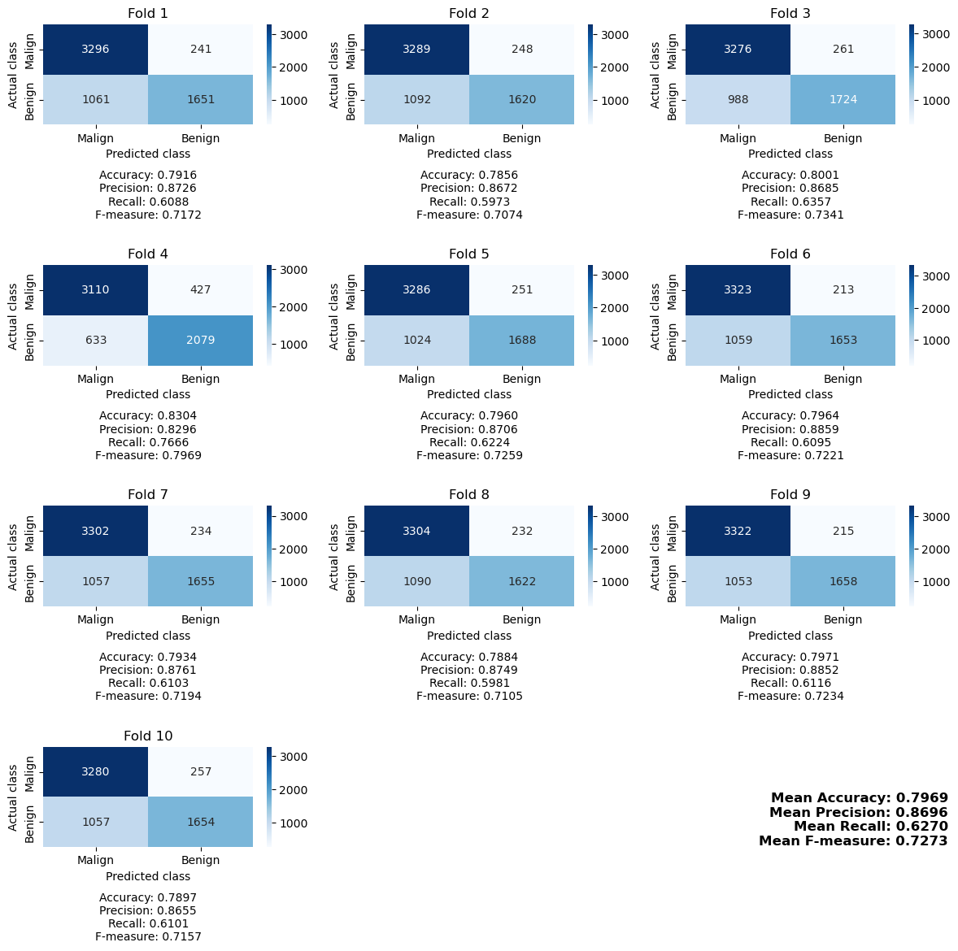
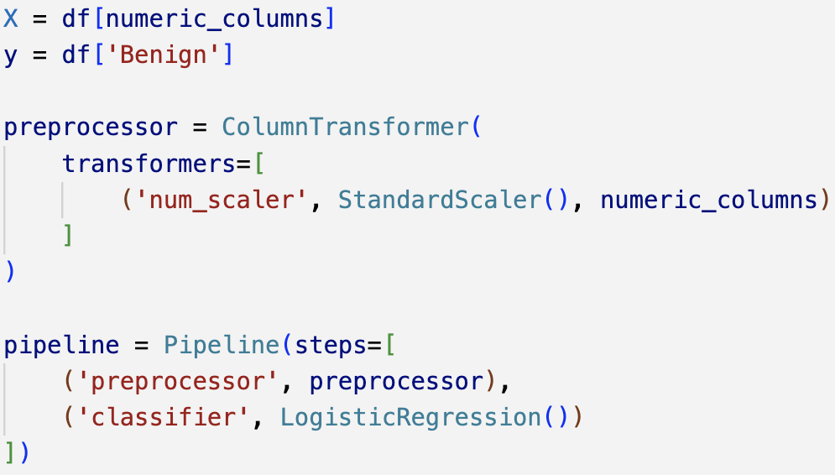
1st Experiment: Logistic Regression with Numeric Features
Data Processing
As already said, since the numerical features have different scales, we apply a pre-processing phase in which we normalize them using Standard Scaler.

Slide 30
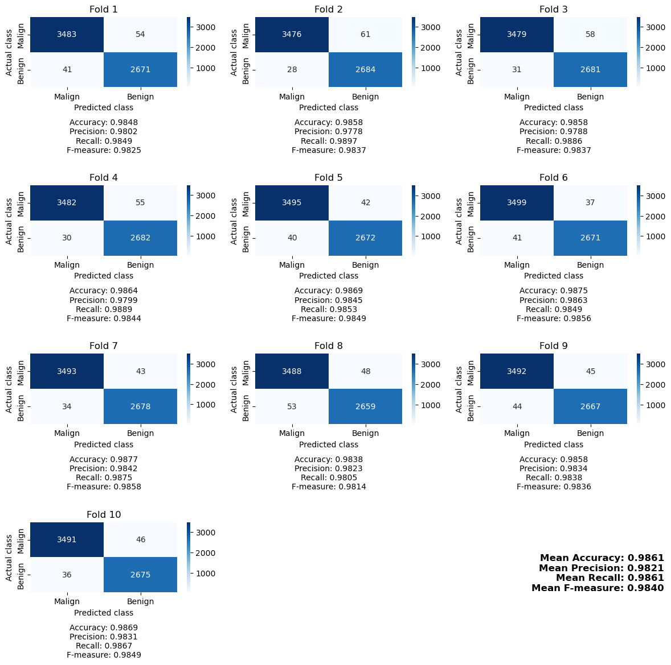
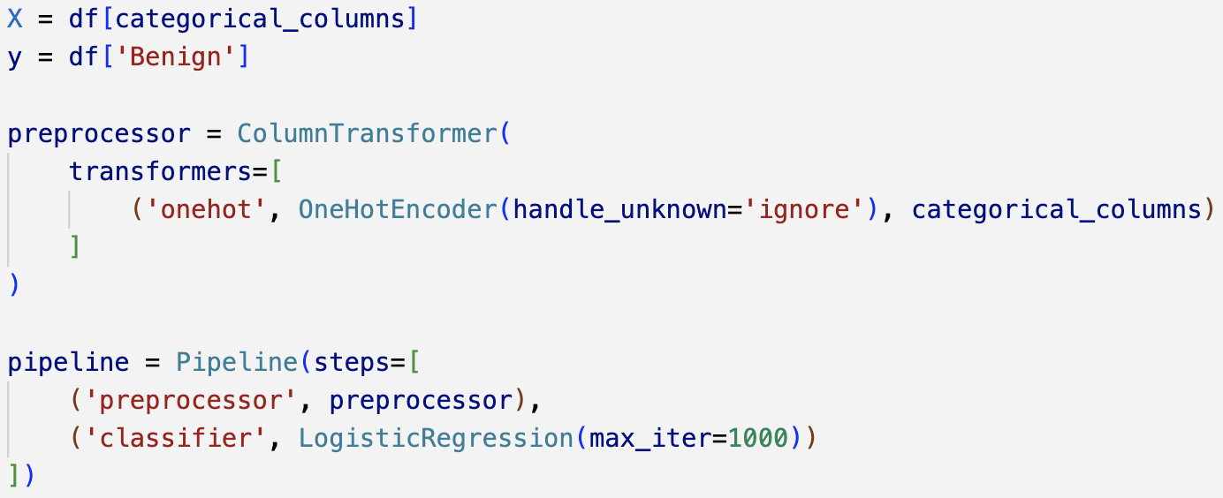
2nd Experiment: Logistic Regression with Categorical Features
Data Processing
Before training the model, it is necessary to apply preprocessing to encode the categorical features. To do so, we use One Hot Encoder.

Slide 31
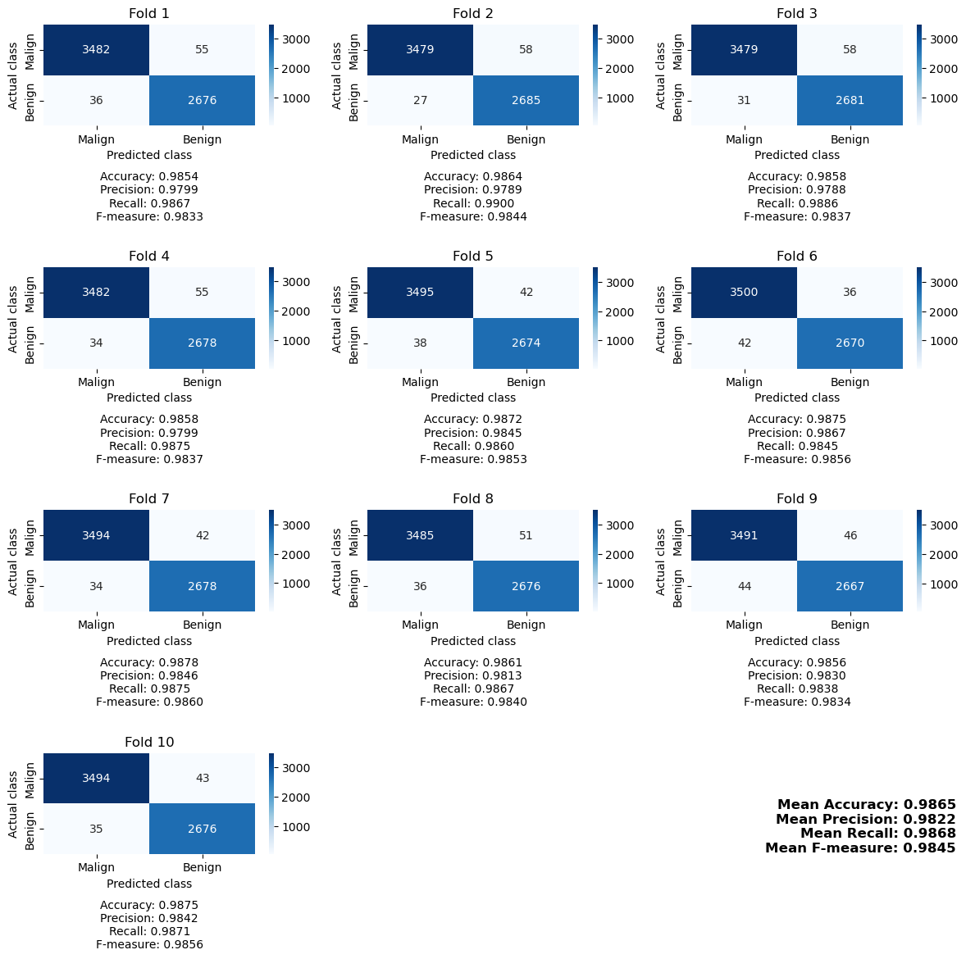
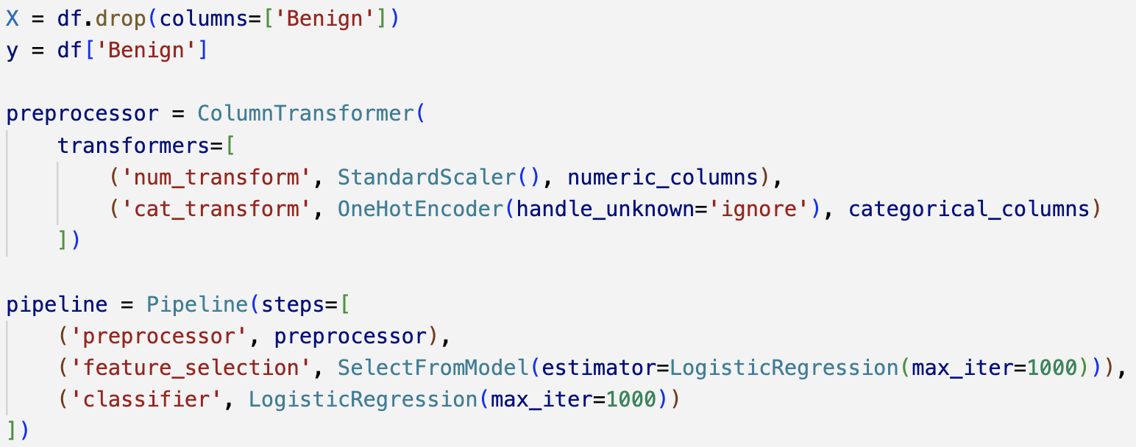
3rd Experiment: Logistic Regression with Whole Dataset
Data Processing
In this experiment, we implemented a structured pre-processing phase consisting of the following steps:
- Normalization of numerical features.
- Encoding of categorical features to make them suitable for the model.
- Feature selection to reduce redundancy and enhance accuracy.

Slide 32
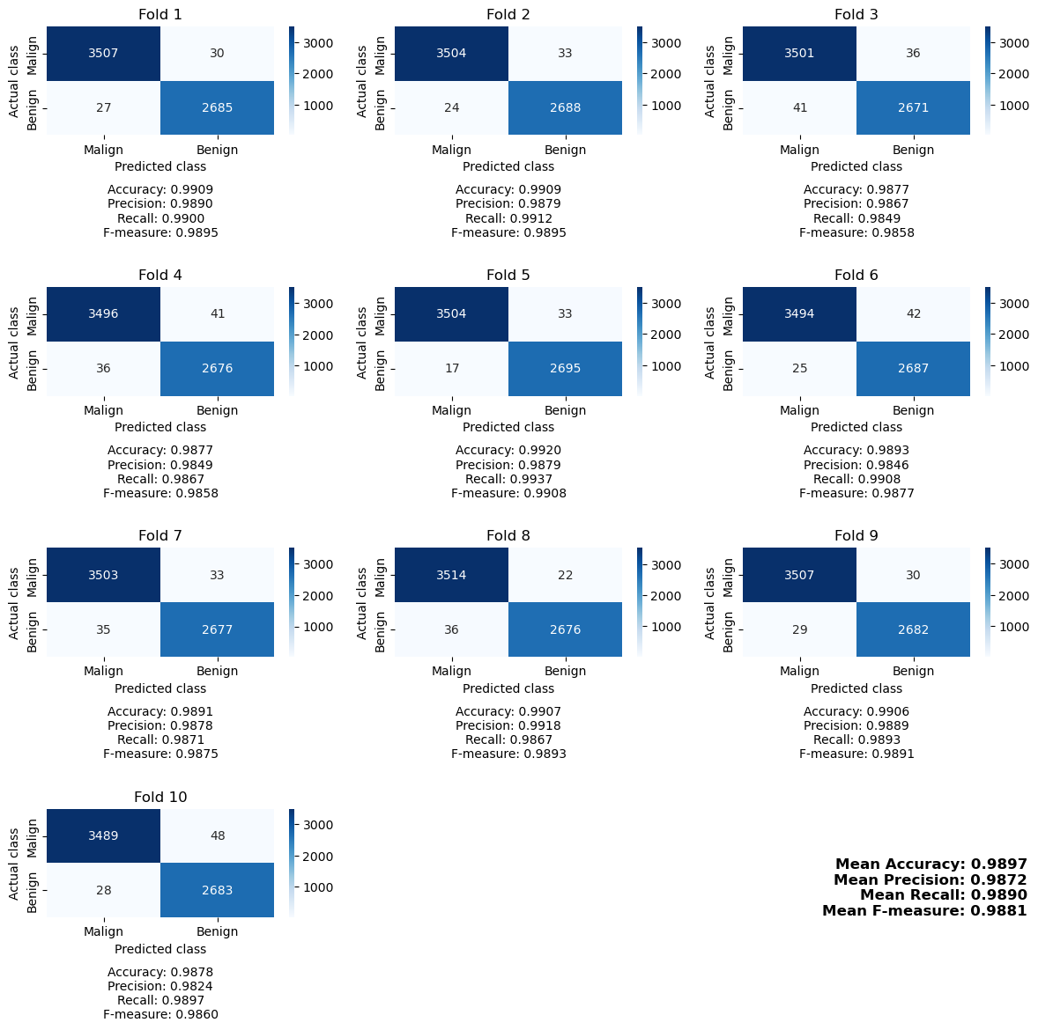
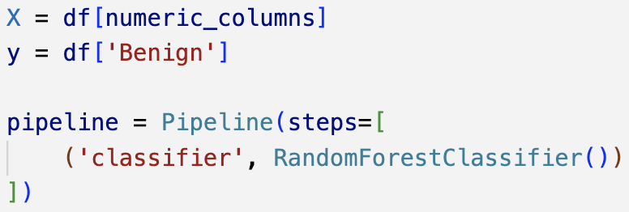
4th Experiment: Random Forest with Numeric Features
Data Processing
We do not scale variables because Random Forest is based on decision trees, which are scale invariant.

Slide 33

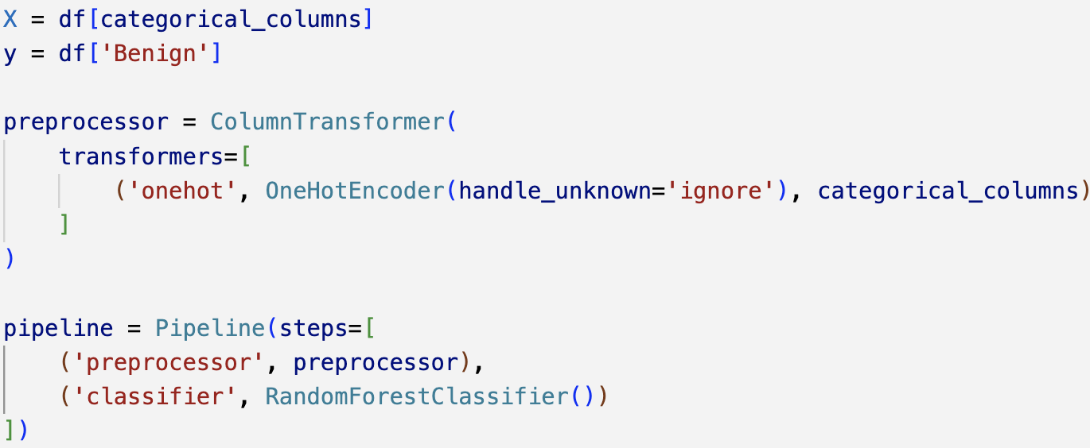
5th Experiment: Random Forest with Categorical Features
Data Processing
Since Random Forest of scikit-learn does not manage categorical variables, we first encode them using One Hot Encoding.

Slide 34

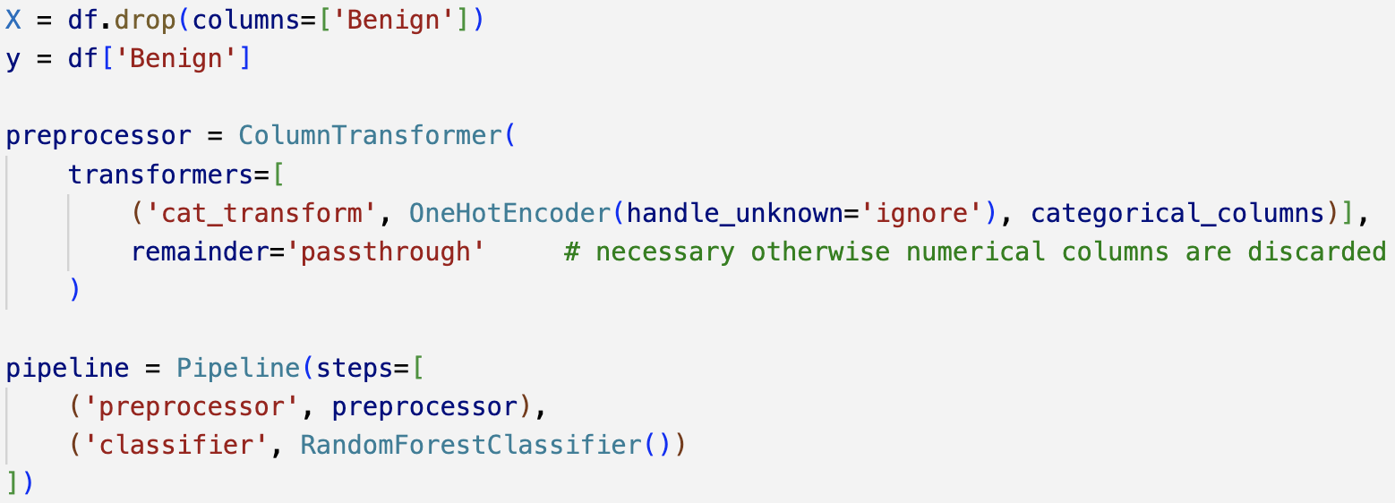
6th Experiment: Random Forest with Whole Dataset
Data Processing
No need of scaling numeric features.
As always, we encode categorical variables with One Hot Encoding.
Feature selection is not necessary because Random Forest inherently handles it during the tree construction process.

Slide 35
Identification of malwares from Windows PE files
Goal Definition
Data Acquisition and Data Exploration
Data Preprocessing
Data Processing
Table of Contents
Result Summary and Relevant Insights
xAI
References

Slide 36
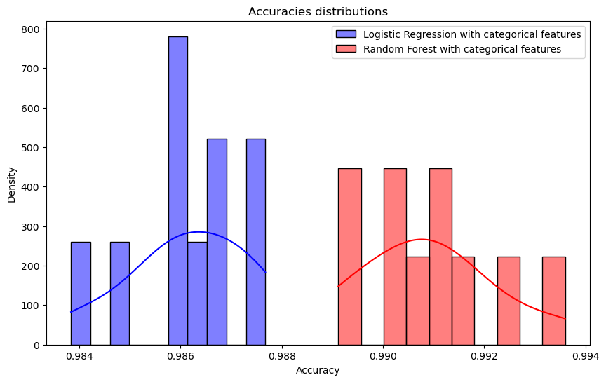
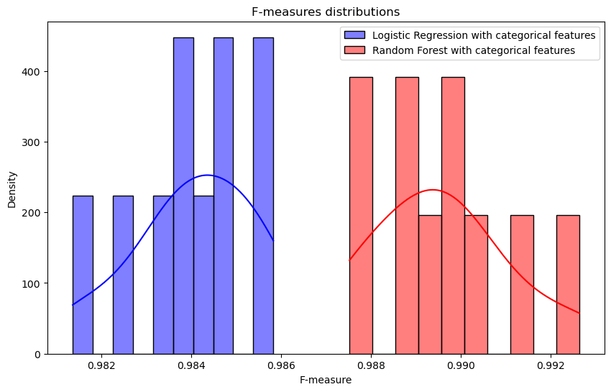
Results Distribution
 | Experiment 1 | Experiment 2 | Experiment 3 | Experiment 4 | Experiment 5 | Experiment 6
Acccuracy | 0.7969 | 0.9861 | 0.9865 | 0.9898 | 0.9910 | 0.9970
F-Measure | 0.7273 | 0.9840 | 0.9845 | 0.9883 | 0.9897 | 0.9965
Result Summary and Relevant Insights
From the distribution of the accuracies and F-Measures over each fold of Logistic Regression and Random Forest we can see that those measures have a Gaussian distribution. In fact, the Gaussian bell is quite visible even though the number of samples is quite low (10)

Slide 37
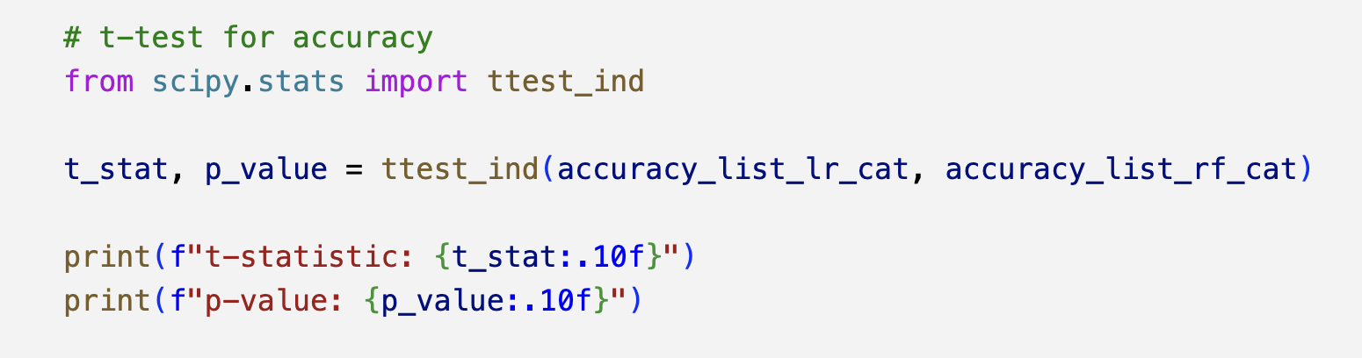
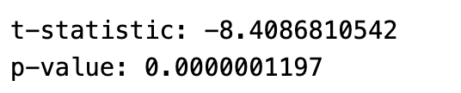
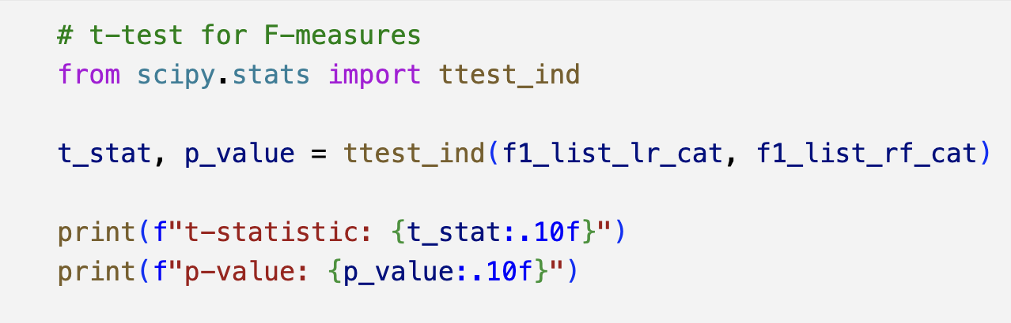
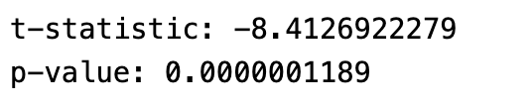
T-Test
Result Summary and Relevant Insights
Given the statistical evidence of the difference in performance between the two models, we can conclude that, since Random Forest is better in both accuracy (0.9910 vs 0.9861) and F-measure (0.9897 vs 0.9840), it performs better than Logistic Regression.

Slide 38
Identification of malwares from Windows PE files
Goal Definition
Data Acquisition and Data Exploration
Data Preprocessing
Data Processing
Table of Contents
Result Summary and Relevant Insights
xAI
References

Slide 39
xAI
For our classification problem, we used Logistic Regression and Random Forest, which have notable differences in terms of explainability:
Logistic Regression is a white box model, meaning that is easily explainable by displaying the coefficients used for the classification.
Random Forest is a black box model, meaning that we need post-hoc techniques such as SHAP values to be able to explain the model.
Since we've seen that categorical features offer a very good balance between performances and computational effort, we're going to explain Logistic Regression and Random Forest when using categorical variables for classification.
We explain the Linear Regression classifier using both coefficients and SHAP
We explain the Random Forest classifier using SHAP

Slide 40
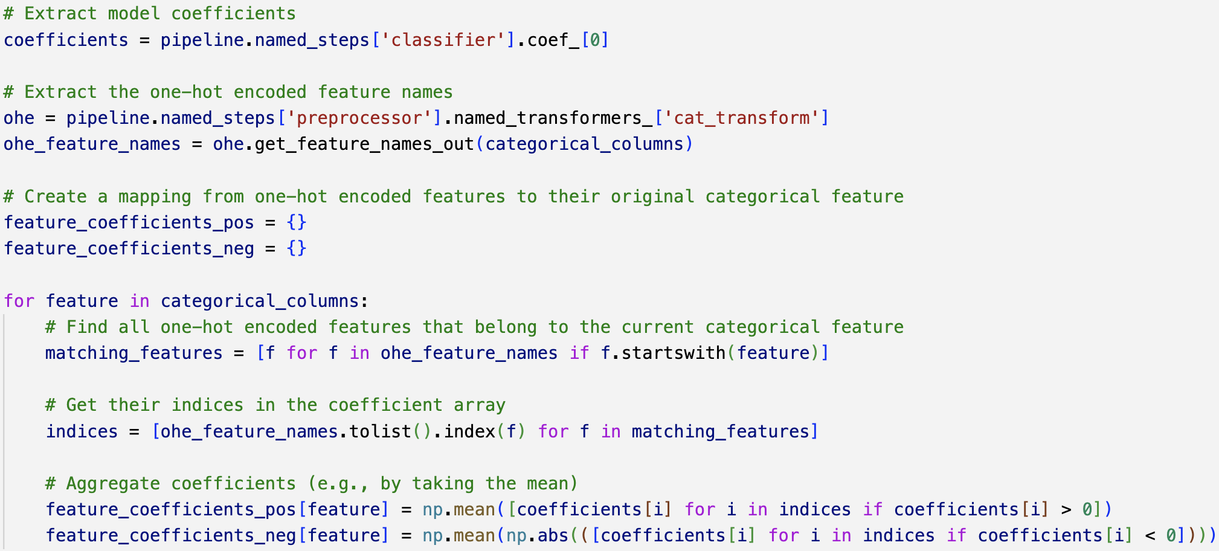
Logistic Regression Explainability using Coefficients
xAI
For each fold of the 10-fold cross-validation, we evaluate how much each categorical feature contributes to distinguishing between the "Benign" and "Malicious" classes. Since one-hot encoding expands each categorical variable into multiple binary variables, the coefficients of these encoded features are grouped and averaged to reflect the importance of the original categorical variable.
Positive coefficients push the prediction toward "Benign," while negative coefficients push it toward "Malicious." This approach allows us to understand which features consistently support or oppose the target class across the folds.

Slide 41
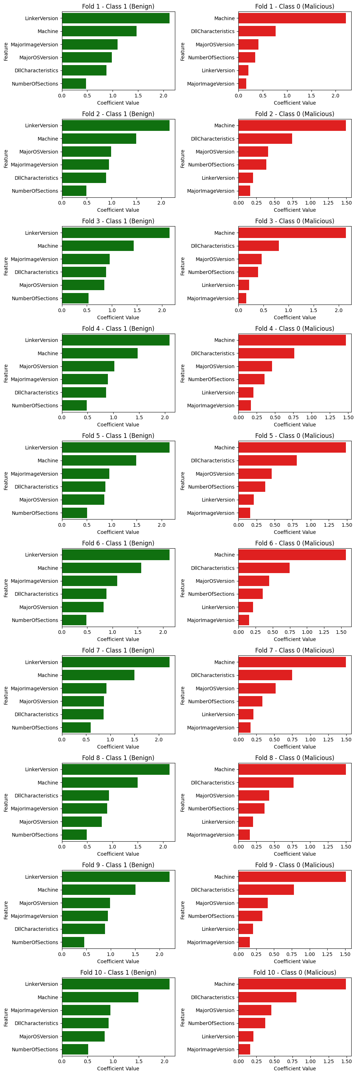
xAI

Slide 42

Logistic Regression Explainability using SHAP
xAI
Since SHAP values are computed for the one-hot encoded features, we group them back into their original categorical feature for both class 0 (Malicious) and class 1 (Benign). Therefore, for each fold, we display the aggregated SHAP value of each original categorical feature for both classes.

Slide 43




















xAI

Slide 44

Random Forest Explainability using SHAP
xAI
As before, SHAP values computed for the one-hot encoded features are grouped into their original categorical feature for both classes.
At the same time, for each fold, we display the aggregated SHAP value of each original categorical feature for both classes.

Slide 45




















xAI

Slide 46

Thanks for your attention

Slide 47

Dataset
Info on PE files
References
Identification of malwares from Windows PE files
Scikit
Seaborn
SHAP
Pandas
Numpy

